Slide 1
Enomoto Screw press
ENOMOTO MACHINE CO., LTD.
201909
Notes:
Good afternoon ladies and Gentleman.
My name is Sumire Enomoto, Sales section of Enomoto Machine from Japan.
Today’s presentation, the title is “ Vertical Upsetter”.

Slide 2
TOPICS
0. COMPANY INFORMATION
WHAT IS A “SCREW PRESS”?
VERTICAL UPSETTER
OTHERS
Notes:
Here are today’s topics.
In advance, I’ll introduce our company.
Then, I introduce what is the screw press,
Next, what is the vertical upsetter,
Finally I let you know our booth information.

Slide 3
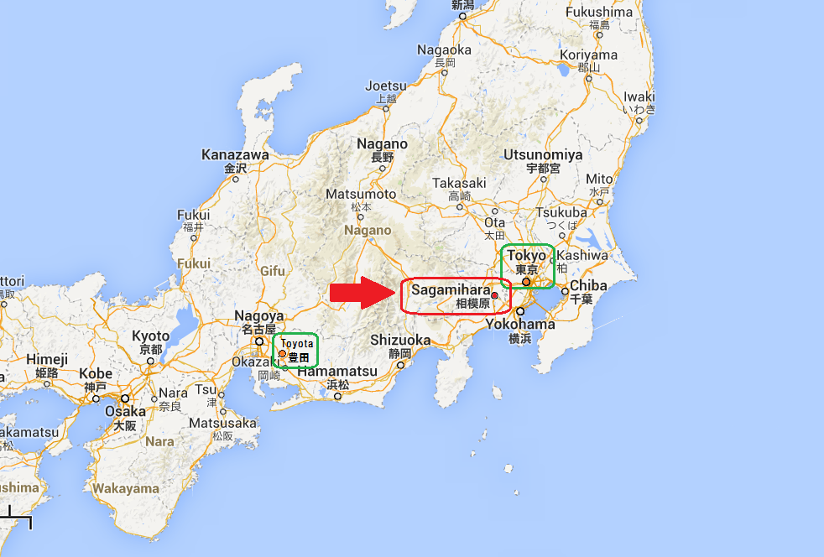
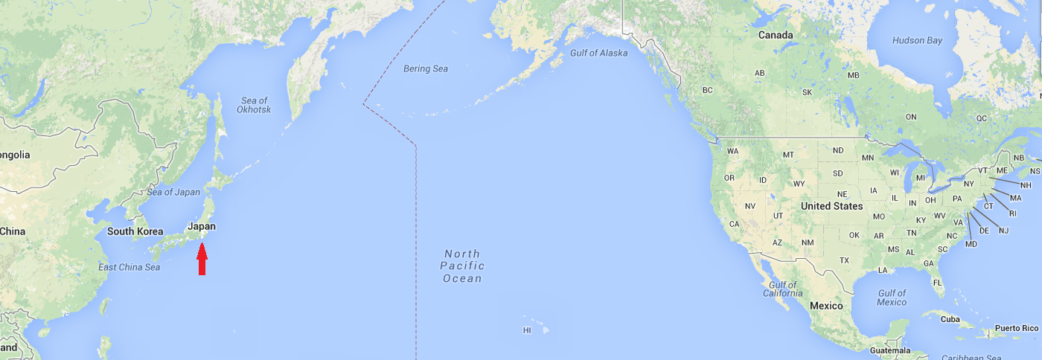
Company information
Notes:
Our company locates Kanagawa prefecture in Japan, south Tokyo.
This is Tokyo, This is Toyota in Nagoya, Here, our Sagamihara city.
Now it’s spring, final cherry blossom season.

Slide 4
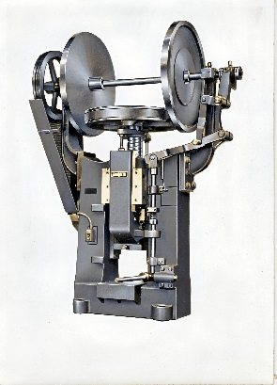
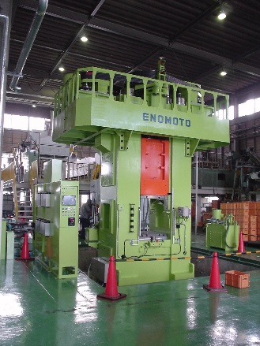
COMPANY INFORMATION
1915…
1954…
1984
1988…
2008
2015
ENOMOTO IRON WORKS was established by Shintaro Enomoto, the grand father of the present CEO, in Tokyo as the Screw Press maker.
ENOMOTO IRON WORKS Co., Ltd. was incorporated by Fukuyoshi Enomoto, the father of the present CEO.
The factory moved to Kanagawa pref, South of Tokyo.
ENOMOTO MACHINE Co., Ltd.was founded by the present CEO, Yoshio Enomoto.
The factory was designated as a model factory in Kanagawa pref.
The new factory opened Feb this year.
Notes:
This year our company are having 100th anniversary.
I introduce our factory’s short history.
In 1915, ENOMOTO IRON WORKS was established by Shintaro Enomoto, the grand father of the present CEO, in Tokyo as the Screw Press maker.
In 1954, ENOMOTO IRON WORKS Company Limited. Was incorporated by Fukuyoshi Enomoto, the father of the present CEO.
In 1984, All factories are gathered at Kanagawa pref, South of Tokyo, present place.
In 1988, ENOMOTO MACHINE Company Limited. was founded by the present CEO, Yoshio Enomoto.
In 2008, The factory was designated as a model factory from Kanagawa pref.
The new factory is now started running as 100th anniversary’s project.

Slide 5
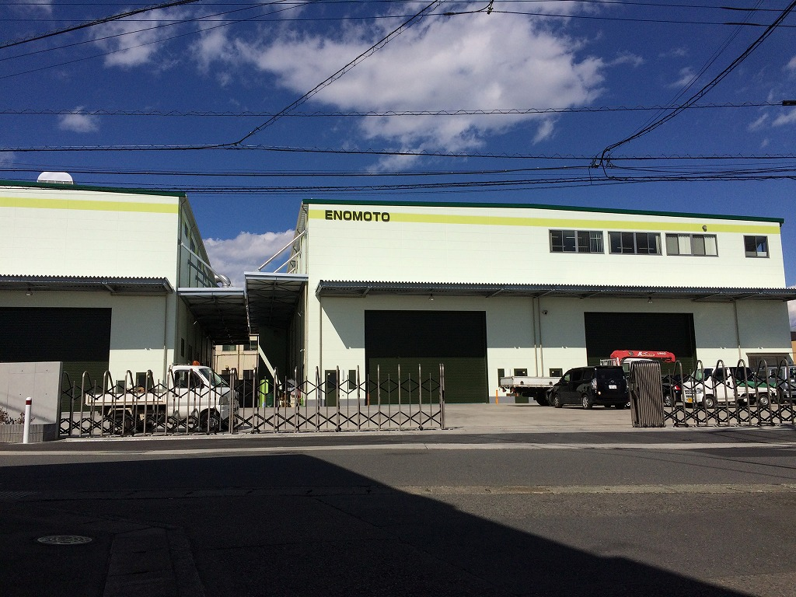
This is our factory.
Notes:
This is our factory.
The number of employee is 33.

Slide 6
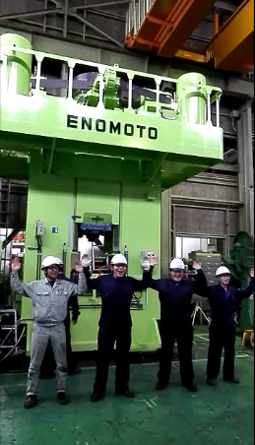
MAIN PRODUCTS AND MARKETS
We make all kinds of Screw presses.
capacity from 100 t to 2000 t
MARKETS
Domestic companies :
Main Automobile Maker
(TOYOTA, NISSAN, HONDA, SUZUKI and so on)
Oversea countries :
India, Indonesia, Thailand, Vietnam, Korea, China,
and so on
Notes:
We make all kinds of screw presses , capacity from 100 ton to 2000 ton.
Now user are mainly Automobile Maker and parts maker, for example, TOYOTA, NISSAN, HONDA, SUZUKI and so on.
Other industry, watch maker like CITIZEN, water faucet maker like Lixil.
We export machines for mainly asia countries, India, Indonesia, Thailand, Vietnam, Korea, China and so on.

Slide 7
1. WHAT IS a “SCREW PRESS”?
Notes:
1st topic is what is the screw press?

Slide 8
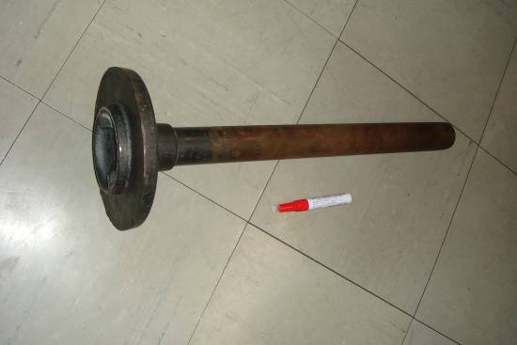
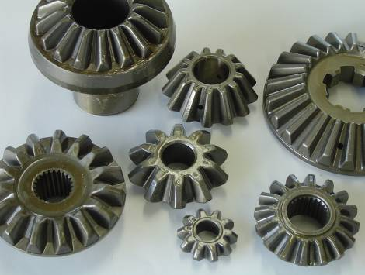
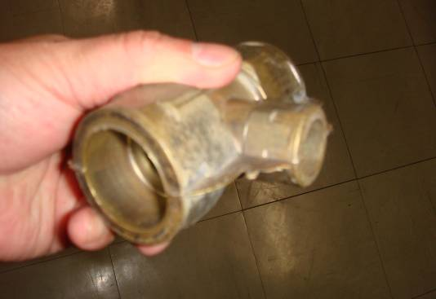
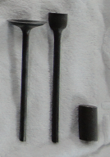
MAIN COMPONENTS made by the screw press
Parts: Automobile parts, Water faucets, Watch frames, refractories and so on
Material: Steel, Aluminium, Brass, Titanium, Magnesium, refractories and so on
Notes:
I show you some samples, Rear axle shaft, vebel gear, engine valve, water faucet.
These components are made by screw presses from around 200 ton to 1600 ton.
The main industries of users are automobile parts, water faucets, watch frames, refractories and so on.
This press can press many materials, steel, alminium, blass, titanium, magnesium, refractories and so on.

Slide 9
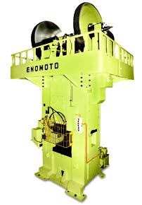
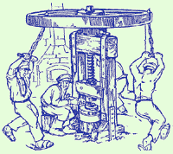
WHAT IS a SCREW PRESS?
Servo Motor Driven, the latest type Ancient one Friction Driven, the past type
Notes:
Screw press has very long roots over the human history.
The center picture is taken from brochure of ハーゼンクレーバー company.
Originally, screw press has been started by the Squeezing machine for Olive or Grape to make Oil or Wine.
This is a Human power driven screw press with wooden frame.
Gutenberg printing machine is also one of the Screw press, so that The Papers and Publishing companies are also using the name of PRESS.
This right picture is old type of our product, friction driven screw press.
The fly wheel is controlled by this friction discs.
The left picture is current type, servo motor driven screw press.
The fly wheel is controlled by these servo motors.

Slide 10
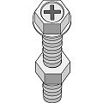
Screw mechanism
Flywheel
This machine has pair of the male and the female screws.
The male screw rotates, then the female screw moving up or down.
The male screw has flywheel.
The ram has female screw.
When the flywheel rotates by high speed, the ram moves fast.
This torque power changes to the forging energy.
Male
Screw
Female
Screw
Ram
Notes:
Basically current screw press has same structure with ancient one, the combination of male and female screws.
The male screw rotates, then the female screw moving up or down.
The male screw has flywheel.
The ram has female screw.
When the flywheel rotates by high speed, the ram moves fast.
This torque power changes to the forging energy.

Slide 11
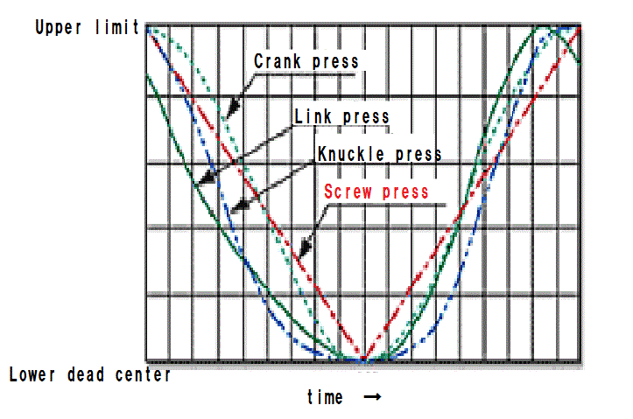
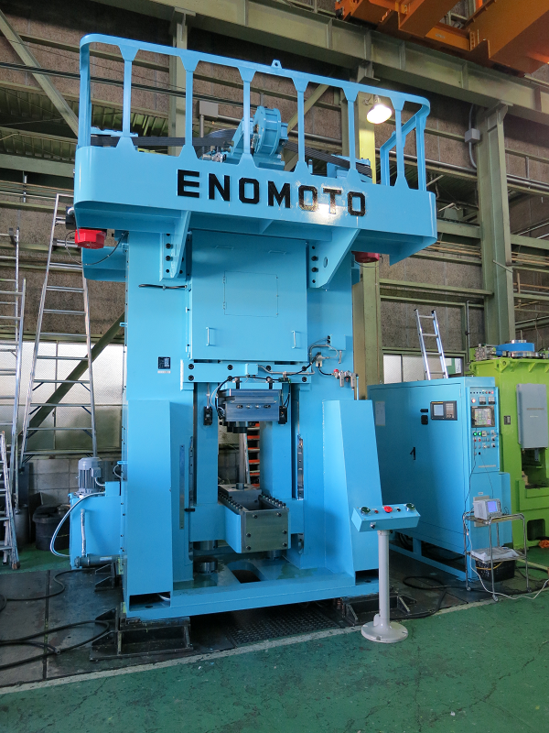
FEATURES
No dead point. Die change is easy.
Powerful and the die contacting time is very short.
Servo motor driven type
Forming program
Automation
Almost maintenance free and low machine cost.
Energy save
Notes:
After accelerated, the screw stops when all motion energy is consumed as deformation energy. So, This machine has no lower dead center, in other words, the pressing point is changing with the condition. You don’t have to consider the thickness of raw material. Also, Die change is very easy and quick. So, 1 machine can make different components.
Forming speed during forging is very rapid (from 500 to 1000 mm/sec).
Especially it gives appropriate speed for hot and warm forging.
Ram rebounding motion during operation also improves die life longer because of shorter die contacting time to the heated raw material.
The figure illustrates crank motion characteristics curve among ordinary crank press, knuckle joint press and screw press.
It can be aware the screw press has very high ram speed at around the point of LDC (lower dead centre), and very short duration time of tool forging onto the material.
Thus the machine can complete the operation immediately before heated material becoming cool.
Ordinary crank press or knuckle joint press sometimes requires Die water cooling for its long contacting time of die and material resulted in extremely raising die temperature.
It’s proven generally that the shorter die contacting time prolongs die life in hot forging.
Now, This machine is the servomotor driven type.
We used to produce this type by Friction driven but now we produce totally Servo type.
Forming program
You can program all values and functions on the touch Screen.
It is easy and clear.
This device has large memory space. Over 200 forging ITEMS can be kept.
So after the trial forge, you can send forging function data to memory part.
Automation
Screw press can be installed into the complete automatic line and still absolutely no skill is required for manual operation.
Almost maintenance free and low machine cost.
System has been changed to Servo motor driven type, this machine doesn't have clutch and brake which need maintenance replacement.
This machine has simple structure, so machine price becomes almost half to compare with Mechanical Upsetting machine.
This machine saves a lot of electric energy.
After every strokes, servo motors themselves stop Ram at the initial position.
So there are no friction mechanical brakes to stop the ram.
In addition to this, During Ram speed down and stop, servo motors regenerate electricity power and push back to the factory.
Moreover, there's no consumption of compressed air never after morning charge.
From these points, this machine saves Electric energy from 30% to 50% comparing with the Friction driven type, in the past.

Slide 12
2. VERTICAL UPSETTER
Notes:
Next, I introduce our unique screw press.
The name is vertical upsetter.

Slide 13
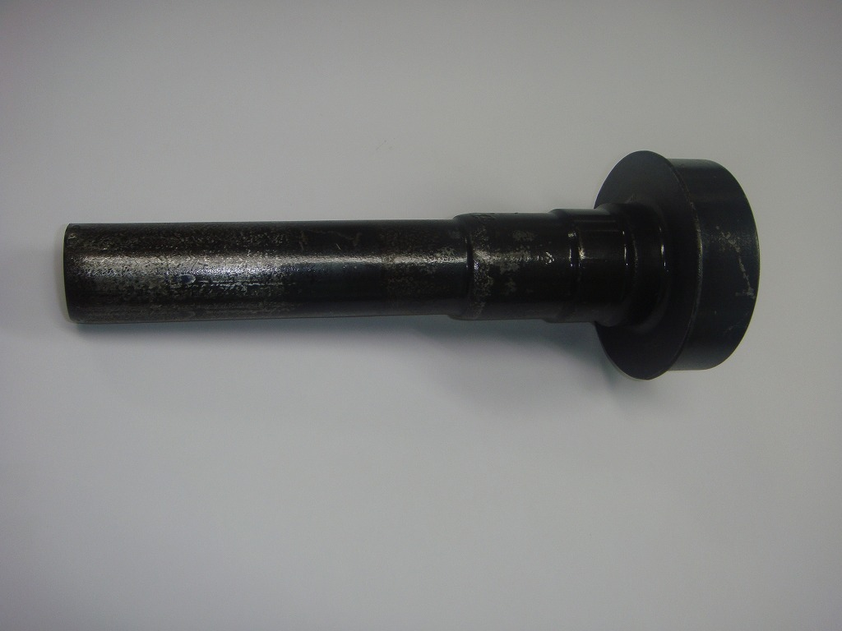
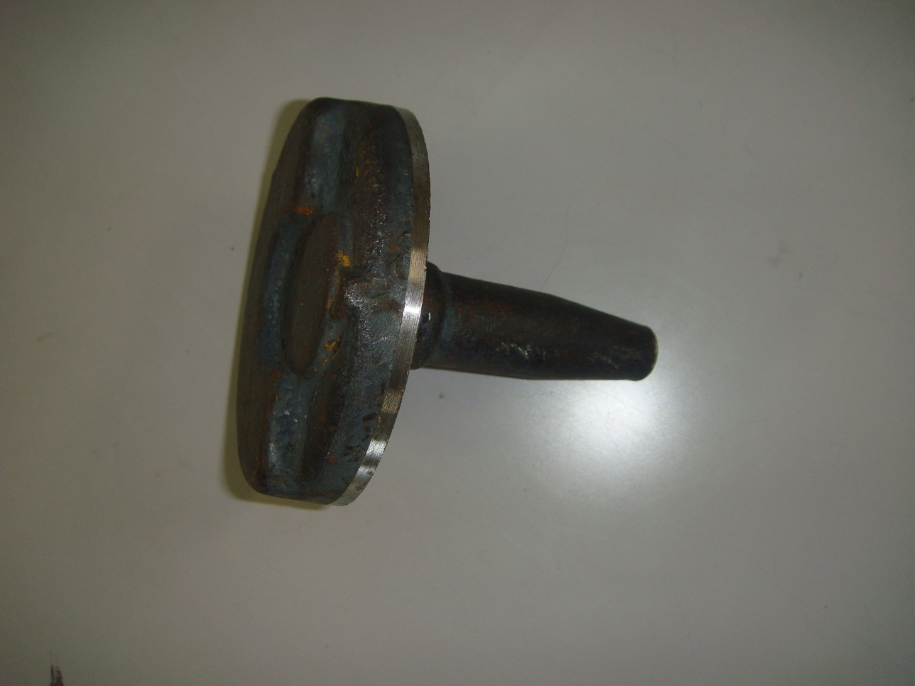
SPECIAL MACHINE FOR UPSET FORGING
Rear axle shaft, half crank for bicycle, gear blank
Notes:
I show you Upsetting items made by screw press.
Upset forging is the deformation process, to deform shaft end enlarge. Such as Bolt head.
Rear axle shaft; Head diameter is 180mm, made by 1250ton press(ZES(GFH)).
Half crank for bicycle; 600ton press(ZES) by 2 processes
Gear blank; 600 ton press (VES) by 3 process

Slide 14
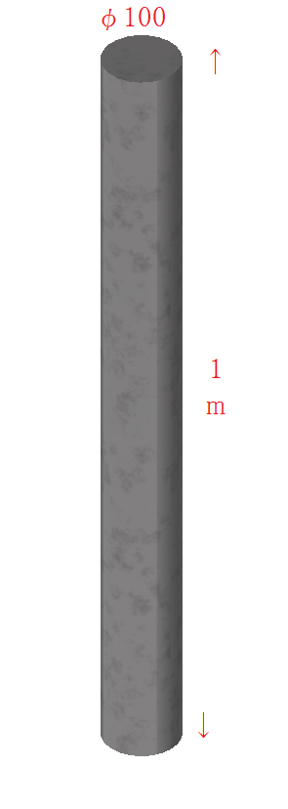
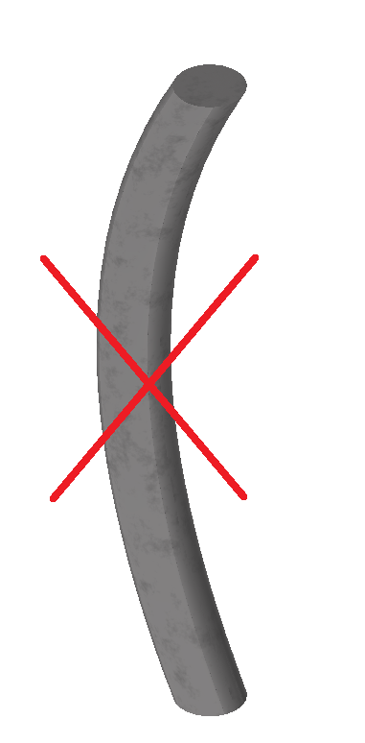
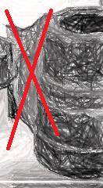
NEEDS OF UPSET FORGING
Longer material
NO Buckling
NO Vertical fin
Notes:
So, What are the matters of upset forging?
longer material
No buckling
No vertical fin coming.

Slide 15
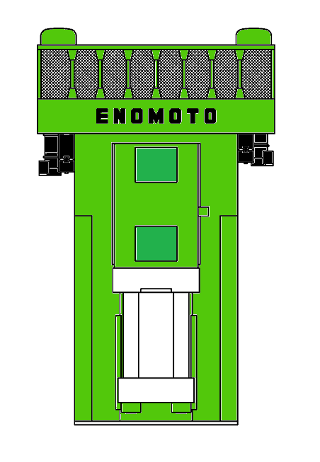
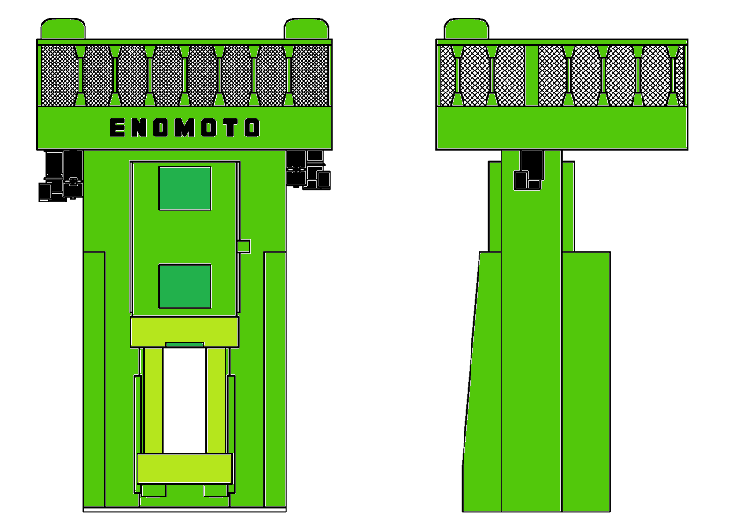
UNIQUE mechanism
Slide goes up, and forges.
Notes:
As solution for these matters,
ENOMOTO’s vertical upsetter, this machine is specialized for Upset forging.
Vertical upsetter has unique mechanism.
This is the picture of Vertical Upsetter Servo Screw Press.
Slide goes up and forges.

Slide 16
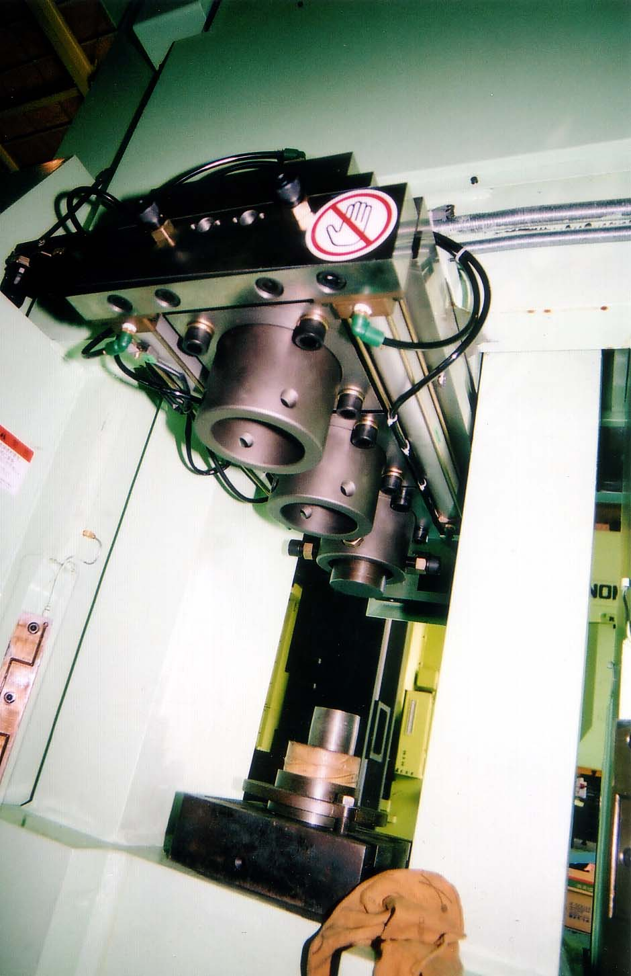
WHY DON’T YOU USE V.U. SCREW PRESS?
Enomoto Vertical Upsetter will solve most problems.
Because of the mechanism, VES solve matters.
Longer material OK
Die shifting, 1-3 steps
Prevent buckling
No vertical fin
No transfer equipment
Easy die re-sink
Adjust material position easily
Simple knock out
Notes:
Longer material
This structure enables to insert very long RAW material.
The material is mainly steel and diameter is almost 100mm, length is maximum 1meter.
Of course, over this size can be acceptable by the special design machine.
Prevention of buckling
Simply speaking, the upset forming is the fight with the buckling.
This forming is the process of hitting one side of the shaft item, step by step and requires to do plastic deformation by incremental forging with free from the buckling problem.
As the solution for the buckling, this machine can set each Power Energy and Stroke Length for 1st, 2nd and 3rd steps as you like.
Because this machine is different from Crank press, there is no Lower dead point . So different position forging, different load energy possible.
There are 2 to 3 upper Dies, changing automatically in every strokes. You can set values on the touch screen.
No vertical fin
Basically, Mechanical upsetter requires Divided Die to insert and take out RAW material. It requires transfers, maximally five positions.
But vertical upsetter, upper Dies are maximum 3, shifting automatically and lower dies is just 1.
Then, there's no need to divide the Die into halves. And more, because of this, forging item does NOT have outer coming longitudinal FIN.
No transfer device require
After inserting the raw material, the press starts the strokes by the signal from the operator or auto devices such as robot.
Then the machine finishes the process by 1st, 2nd and 3rd strokes completely and automatically.
So there’s no need to use complicated, expensive transfer devices.
Of course, it makes Forging process time shorter.
Moreover, You can freely modify and re-sink all Dies respectively.
Raw material adjustment
During the trial forging, top end of raw material position requires slight adjustment, like,
to move down the raw material a little,,,,, because there are too much outer fin there.
or to move up the raw material a little,,,,, because there's some unfilled.
This machine has the adjustment CAP NUT in bottom part to adjust top position of Raw material.
It takes very short time for the adjustment.
Simple Knock Out
After forging, when the slide goes down, the forged item is Ejected by the knock out bar in bottom.
It is so simple structure, no needs of special mechanical Knock Out device or Hydraulic Knock Out device.
And design wise, machine height becomes lower.
Also Floor space becomes smaller.
Vertical upsetter, operation and structure are simple and forging material is without vertical fin.

Slide 17
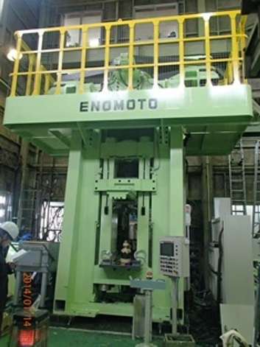
OF COURsE…
This is basically Servo Screw Press.
TOUCH PANEL SETTING, DATA MEMORY
AUTOMATION OK
HIGH SPEED,
PRECISION FORGING
LESS MAINTENANCE
SAVE ENERGY
Initial cost is much lower than the horizontal upsetter.
Notes:
This is one of Servo Screw Press, so of course basically servo merits are there
AUTOMATION OK
HIGH SPEED, PRESITION FORGING
LESS MAINTENANCE
SAVE ENERGY
Initial cost is much lower than the horizontal upsetter.

Slide 18
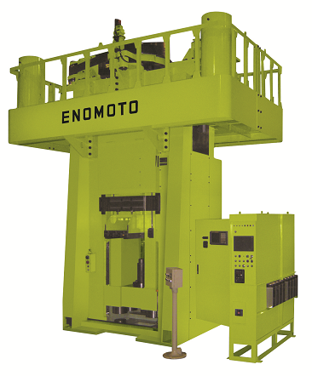
OUR PRODUCTS
VES Series 100-1600 t
Dia. of material : max Φ100mm
Length of material : max 1m
Notes:
Here you’ve got what’s the screw press, what’s vertical upsetter and its merits.
We produce vertical upsetter named VES series, from 100 – 1600 ton.
Diameter of material is maximam 100mm.
Length of material is maximam 1m.
I show you some operating movies.

Slide 19
THE MOVIE OF 150vES
The name of 150 ton vertical upsetter is
150VES.【v:i:es】
MF Tokyo 2011
Notes:
This is movie at MF Tokyo 2011, exhibition in Tokyo 4 years ago.

Slide 20
600VESH AUTOMATION
VESH is High Forming Energy model.
Notes:
This is movie of input shaft of gear mission.(tokai)
600ton vertical upsetter.

Slide 21
THANK YOU FOR YOUR LISTENING.
Notes:
Thank you for your listening.

